Slide 1

Ocean
Acidification
Ocean 215 final project by Liuyixin Shao

Slide 2
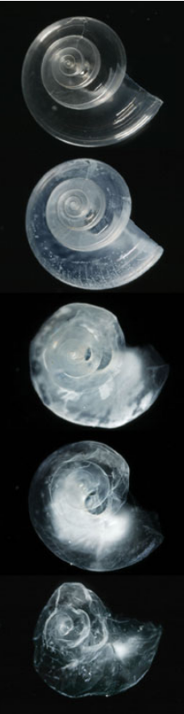
Scientific Background
Ocean acidification is the reduction in the pH value of the Earth’s ocean. The cause of ocean acidification is clear: carbon pollution released by burning fossil fuels, making oceans absorb more CO2 from the atmosphere and format more carbonic acid.
Yet, the seawater is still alkaline, with a pH around 8.1. However, the lowered pH damage calcium-based shells and skeletons from marine calcifying organisms, like mollusks, oysters and corals.
Sources: https://en.wikipedia.org/wiki/Ocean_acidification
https://www.nrdc.org/issues/reduce-ocean-acidification
http://www.chesapeakequarterly.net/V11N1/main1/

Slide 3
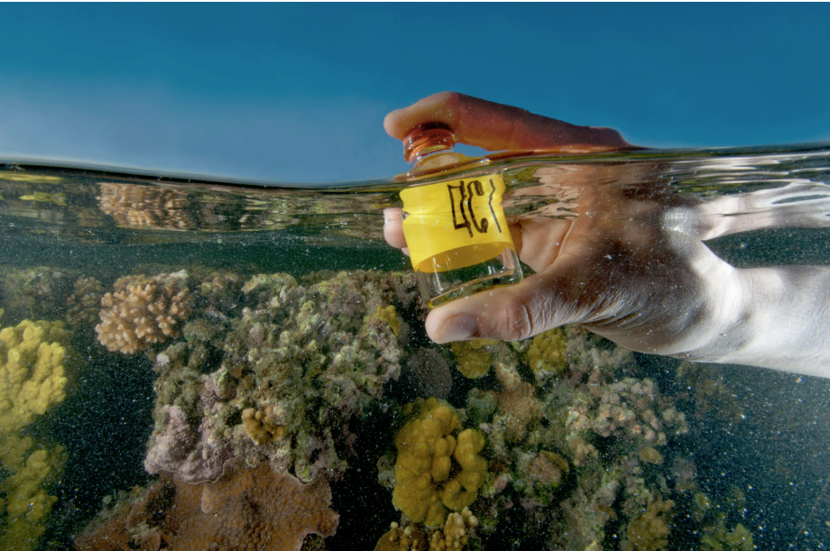
Scientific Question with Hypotheses
Q: Has the pH of seawater on the west coast shown a great decline in recent years？
Hypothesis: Yes. Ocean acidification has been severe in the west pacific ocean. There should be a drop in seawater pH.
Minor Question: What are the general trends in pH changes in seawater near the coast？
Hypothesis: The higher the latitude, the higher the pH of the seawater (more alkaline). The closer to the mainland, the lower the pH of seawater (more acidic).
Sources: https://www.nrdc.org/issues/reduce-ocean-acidification

Slide 4
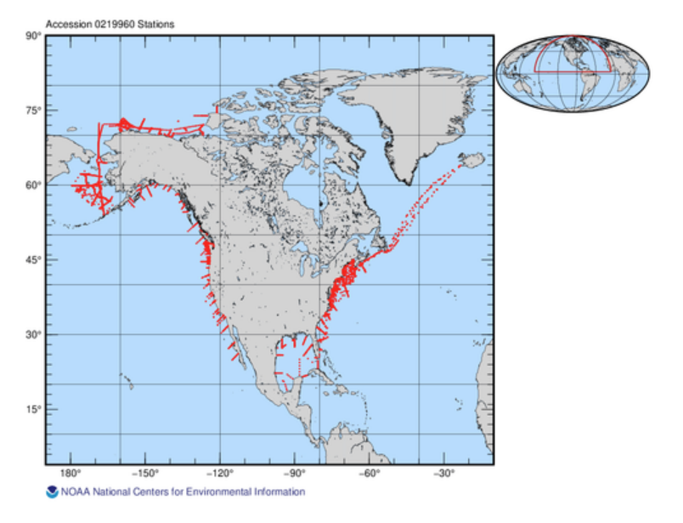
Information about My Data
Coastal Ocean Data Analysis Product in North America (CODAP-NA, Version 2021) (NCEI Accession 0219960)
This version of the CODAP-NA is composed of 3,391 oceanographic profiles from 61 research cruises covering all continental shelves in North America (U.S. west coast, U.S. east coast, Gulf of Mexico, and Alaska coast). It has 28,206 rows and contains the data from 2003-12-05 to 2018-11-22.
One limitation of my data is the lack of deep-water sampling (>1500m.
Sources: https://www.ncei.noaa.gov/data/oceans/ncei/ocads/metadata/0219960.html

Slide 5
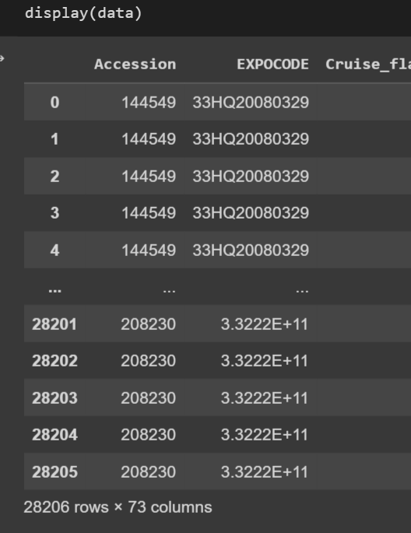
Process for the Analysis
Data file format:
A large csv file (>9,000 KB)
28,206 rows
73 columns
1, Setup:
Import all the necessary libraries, find the number of headers, and read the csv file
2, Initial Data Cleaning:
Replace -999 to np.Nan
Form a dataset with only variables I will use
Combined the 3 time columns into one new column called 'date', and changed them into datetime objects
3, Actual Plotting Part:
Plot 1 (general data distribution): use cartopy to plot where my data located

Slide 6
Process for the Analysis
Data file format:
A large csv file (>9,000 KB)
28,206 rows
73 columns
Plot 2 (compare of seawater pH in the west coast by year):
Slice the dataset to get the west coast data for 2012 and 2017
Use cartopy to plot the West Coast Seawater pH in Different Years
Plot 3 (the general trend in pH changes in arctic seawater near the coast):
Slice the dataset to get the arctic seawater data
Use cartopy to plot to see the distribution
make the 2 satterplots with linear regression to see the trend among latitude and longitude
(In order to mitigate the effect of changes in seawater acidity at different times and thus focus only on the effect of latitude/longitude on seawater pH, here I have averaged the data for the same longitude/latitude by using groupby(). See more explanations in the Colab Notebook.)

Slide 7
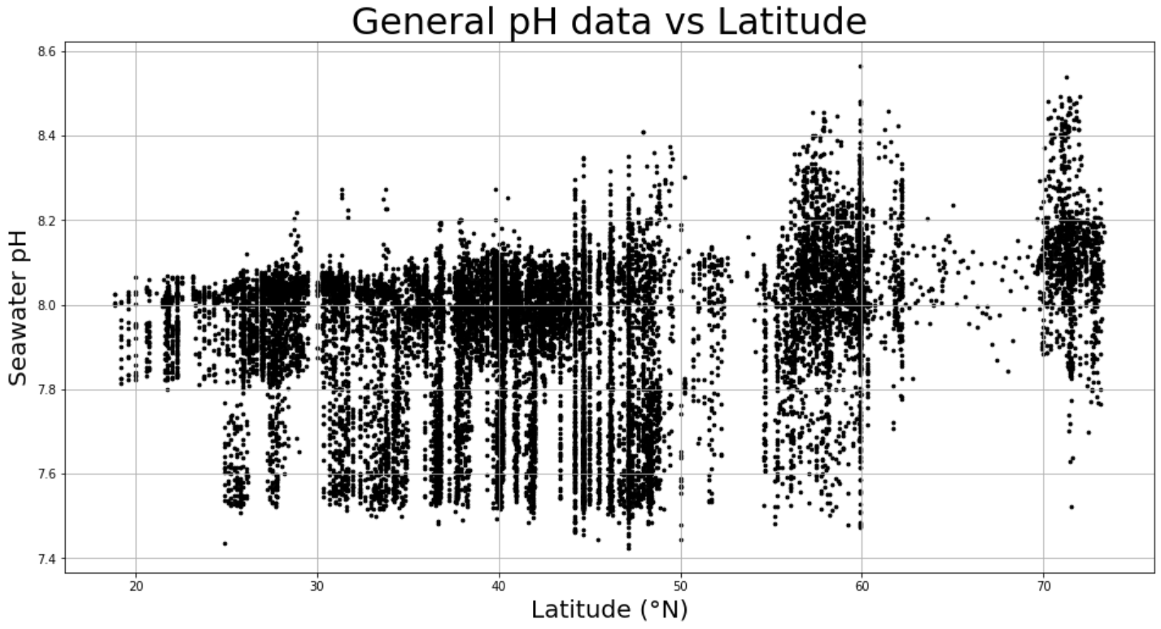
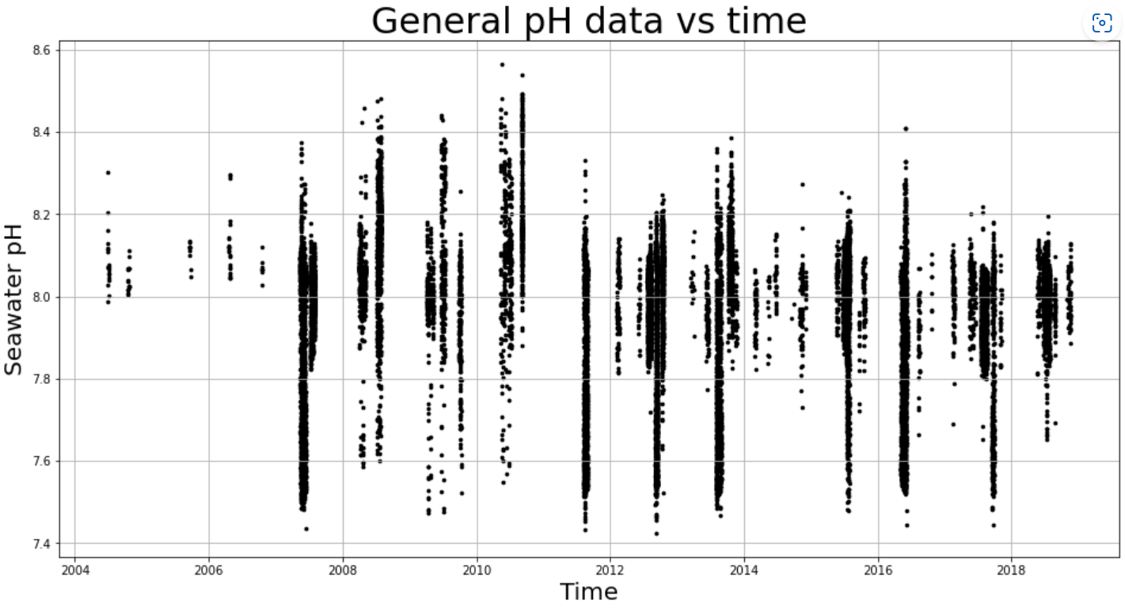
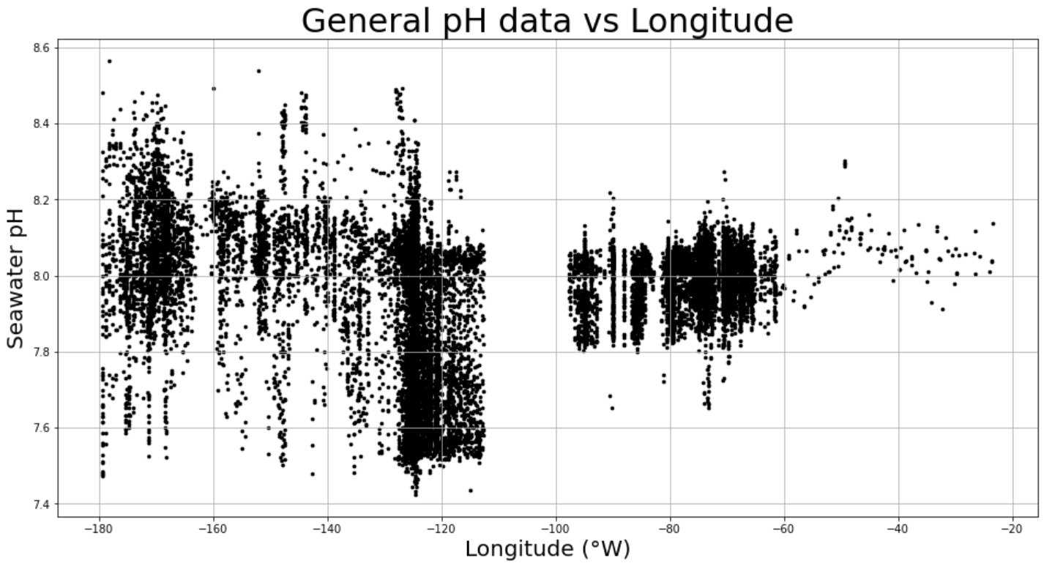
One BIG Challenge
Very messy, hard to find a trend ……

Slide 8
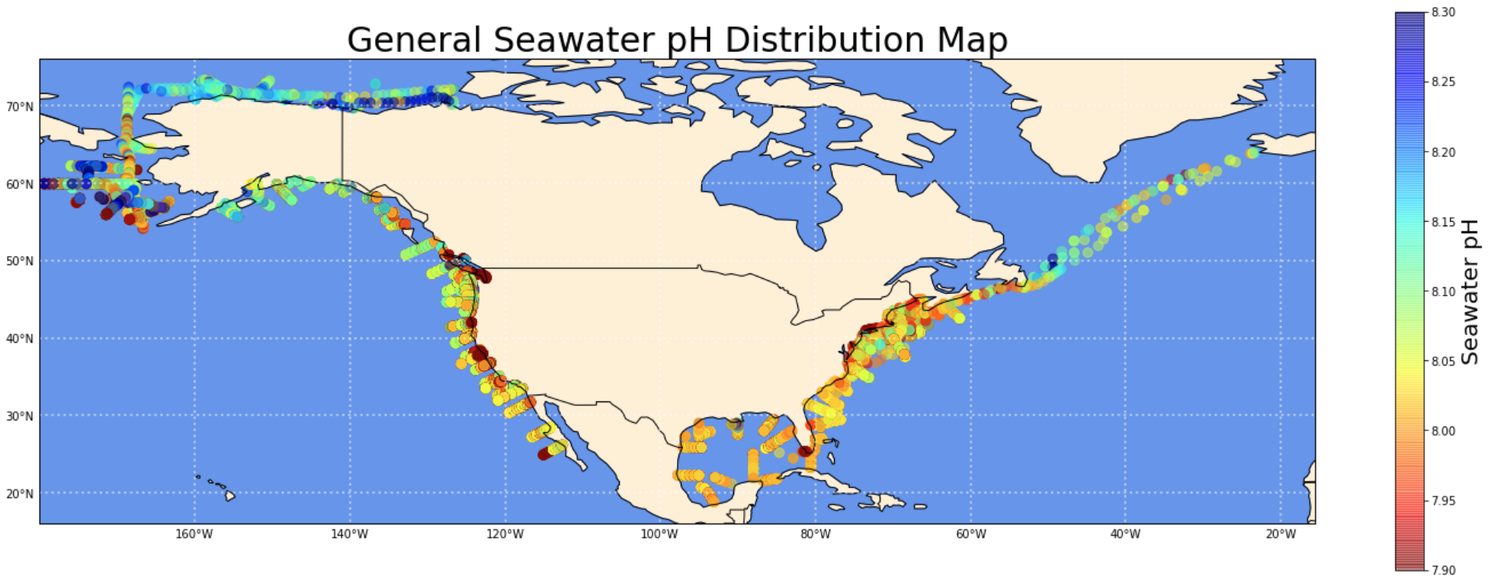
Answer to Scientific Question and Plots
Explanation of the use for the “jet_r” colormap: this colormap corresponds to the result of the pH test paper, as the higher pH, the bluer, and the lower pH, the redder.
From the graph we can see two phenomena: 1) the higher the latitude, the higher the pH of seawater; 2) the closer to the coastline, the lower the pH of seawater (the more serious ocean acidification). (More detailed analysis will be shown in the next two slides.)
Notes:
Explain use for the colormap: because the jet_r colormap correspond to the result of the pH test paper, as higher pH is more blue and lower pH is more red.

Slide 9
Answer to Scientific Question and Plots
From the graph we can see two phenomena: 1) the higher the latitude, the higher the pH of seawater; 2) the closer to the coastline, the lower the pH of seawater (the more serious ocean acidification). (More detailed analysis will be shown in the next two slides.)
Notes:
Explain use for the colormap: because the jet_r colormap correspond to the result of the pH test paper, as higher pH is more blue and lower pH is more red.

Slide 10
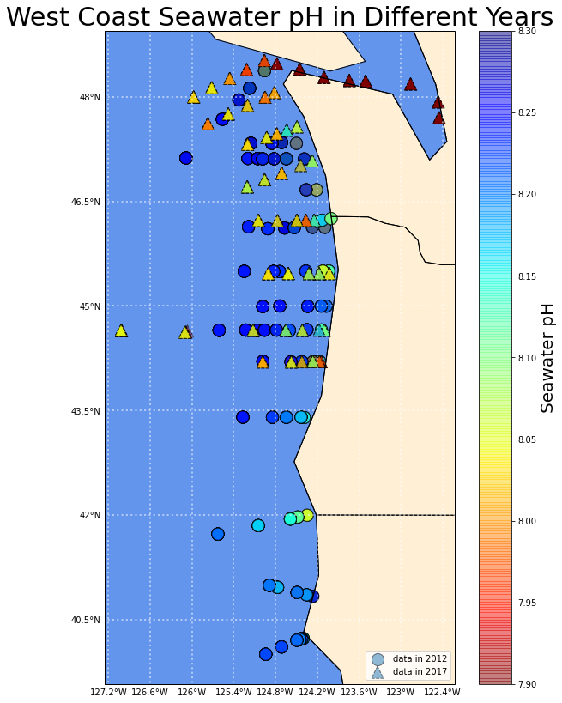

Answer to Scientific Question and Plots
We can see that the water on the west coast has dropped by about 0.15 pH in just 5 years. This indicates that ocean acidification on the west coast is indeed a very serious problem and deserves everyone’s attention.

Slide 11
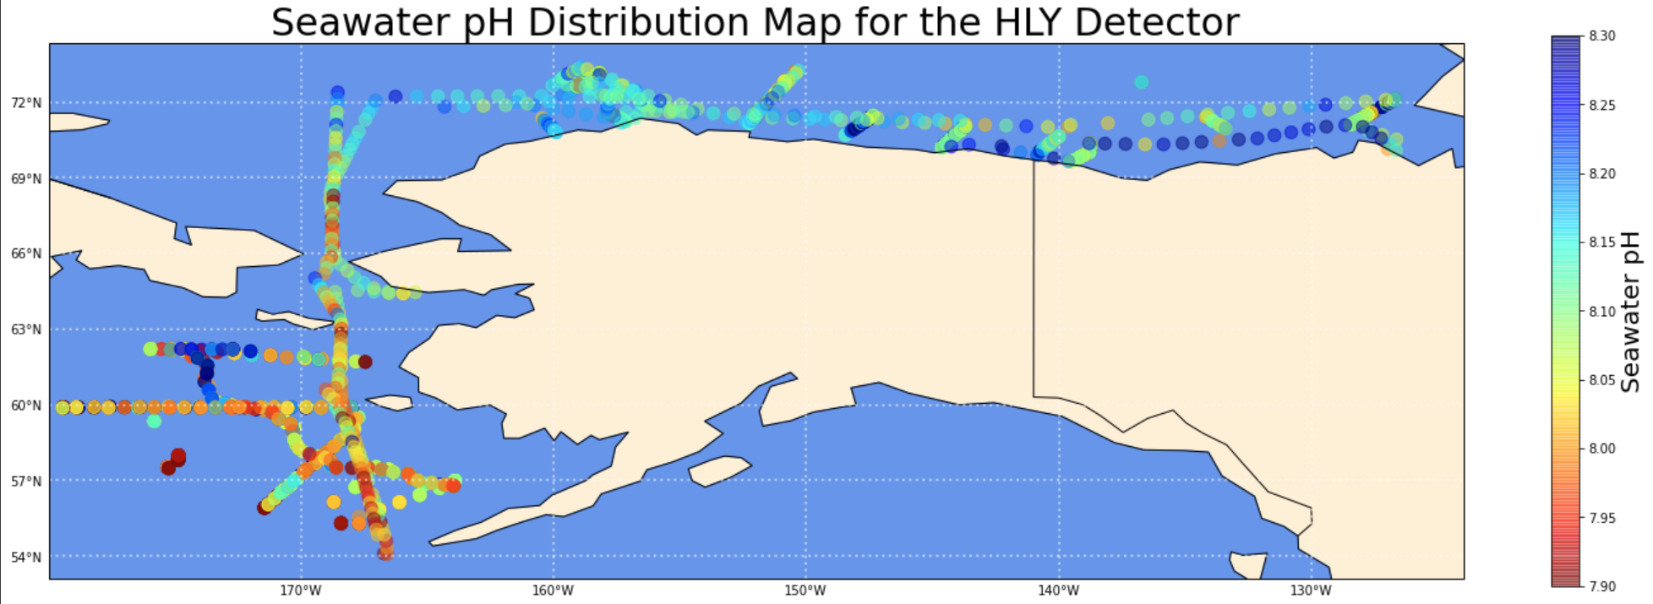
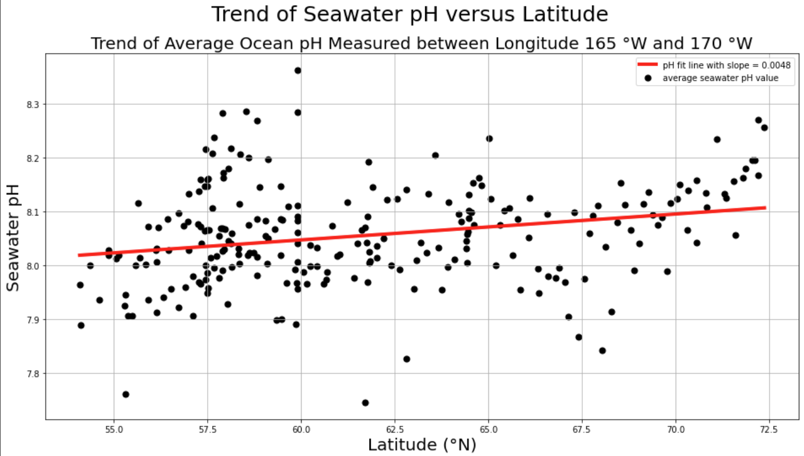
Answer to Scientific Question and Plots
The higher the latitude, the higher the pH of the seawater (more alkaline).

Slide 12
Answer to Scientific Question and Plots
The higher the latitude, the higher the pH of the seawater (more alkaline).

Slide 13
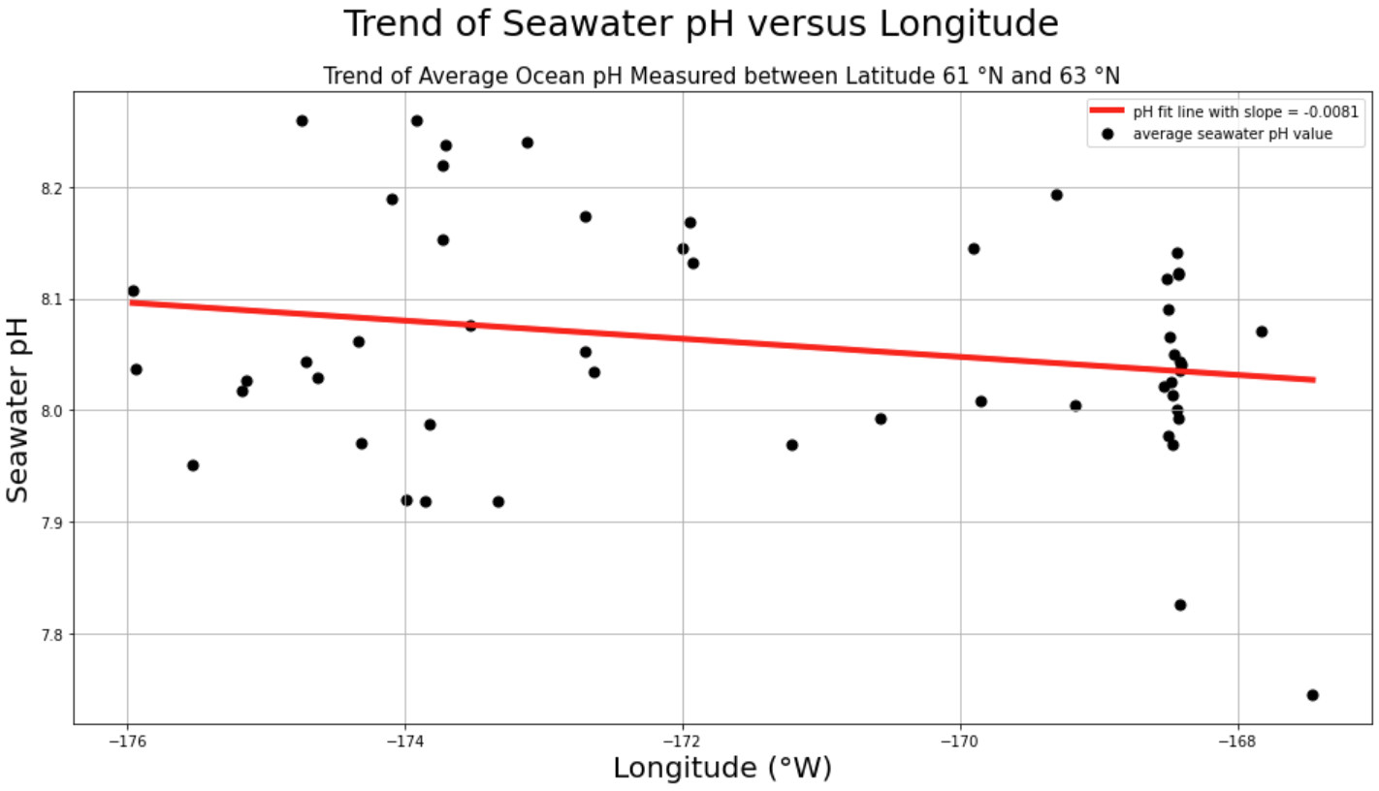
Answer to Scientific Question and Plots
The closer to the mainland, the lower the pH of seawater (more acidic).
Notes:
However, the trend here is not very obvious. Many other factors would affect the pH

Slide 14
Answer to Scientific Question and Plots
The closer to the mainland, the lower the pH of seawater (more acidic).
Notes:
However, the trend here is not very obvious. Many other factors would affect the pH

Slide 15
THANK YOU
Have a nice day!

